Slide 1
Designing Wireframes and Copy
For Web and Mobile Accessibility

Slide 2

Ken Nakata
Director of Accessibility Practices
12 years as a Senior Trial Attorney with the U.S. Department of Justice
Helped shape the government’s policies for the Americans with Disabilities Act and Section 508 of the Rehabilitation Act
Helps organizations manage the change towards accessibility in all aspects
Crafts policies, develops stakeholder ownership, and forges awareness and commitment to the legal and business case supporting accessibility

Slide 3

Jeff Singleton
Senior Accessibility Solutions Consultant, ACP
Over two decades of evaluating and supporting information and communication technology
In depth knowledge of accessibility guidelines, standards and assistive technologies
Lectures on accessibility topics at National and International Disability and Technology Conferences
Developed and taught various training programs and courses focused on accessibility compliance

Slide 4
Accessible Design

Slide 5
Benefits
Minimizes Issues
Minimizes Frustration
Less Effort
Less Cost
Less Effort
Less Cost

Slide 6
Benefits
Minimizes Issues
Deploy
$1,000
Minimizes Frustration
Less Effort
Less Cost
Less Effort
Develop
Less Cost
Design
$1
Time

Slide 7
Wireframes

Slide 8
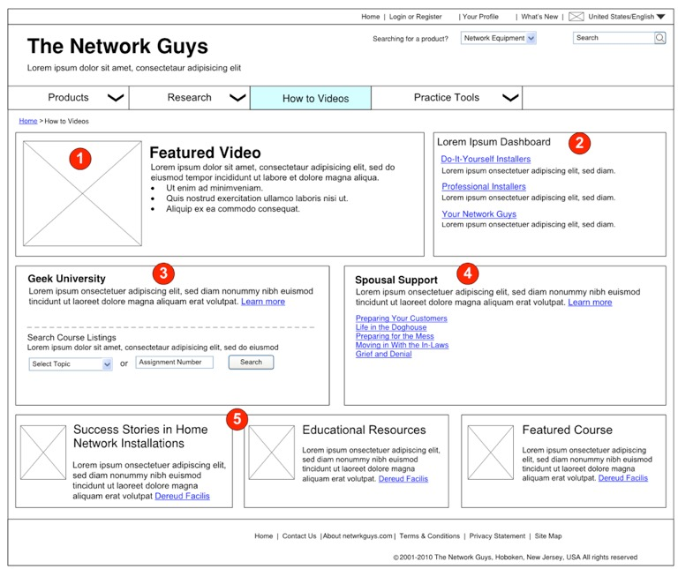
Change of Context

Slide 9
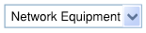
Change of Context
Dropdown w/o Button
Most likely an onChange event
Difficult for Screen Reader & Keyboard Users
Dropdown w/ Button
Gives control to users
Conforms with WCAG 2.0 SC 3.2.2 [On Input]

Slide 10

Proper Use of Header Tags
WCAG 2.0 SC 1.3.1 [Info and Relationships]
WCAG 2.0 SC 2.4.1 [Bypass Blocks]
WCAG 2.0 SC 2.4.10 [Section Headings]

Slide 11
Lists

Slide 12
Link Text

Slide 13
Multimedia

Slide 14
Keyboard
Keyboard
Visual Indication of Focus
Expected Behavior
Tab Order

Slide 15
Avoiding Issues

Slide 16
Document Details
Element | Alt text Written for all images | Title attributes Written for image that prompt the user to action | Long description Written for complete images, such as image maps.
5.2 Thank You Page
Survey | Feedback survey | Complete this survey to give us your feedback
Yes image | Yes
No image | No
5.3 E-mail Preference Layer
Cancel Button | Cancel | Click here to cancel and close this window
Save button | Save | Click here to save settings
Close button in upper-right corner | Close | Click here to cancel and close this window

Slide 17
Enhanced, Custom or Cutting-Edge Controls

Slide 18
Non-Standard/Modified Controls
Bear the full burden of making controls accessible
Etc.
Keyboard
Identification
State
Function
If you create a custom control, take the time to make it right so it can be reused again without having to recreate

Slide 19
Sharing the Work

Slide 20
Don’t Backload Web Accessibility
Design
Copy
Development
WCAG

Slide 21
Sharing the Work
Development
Design
Copy
Designer Checklist
Copy Writer Checklist
Developer Checklist

Slide 22
Inputs and Outputs
Development
Design
Copy
Input Checklist
Input Checklist
Designer Checklist
Copy Writer Checklist
Developer Checklist

Slide 23
Advantages to Using Checklists
1
Flexible
2
Self-policing and built in reminders
3
Eliminates backloading to developers
4
Clearer training
5
Culture of accessibility

Slide 24
Mobile Apps

Slide 25
Basic Principles Apply
Review design to identify potential accessibility issues
Provide enough detail to avoid programming inaccessible features

Slide 26
Contact Us
Jeff Singleton
jeffrey.singleton@cyxtera.com
www.compliancesheriff.com
Ken Nakata
ken.nakata@cyxtera.com

